Slide 1
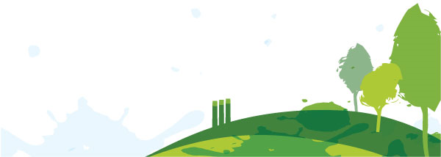
Sharing Water

Slide 2
Part I: Watersheds and Water Users

Slide 3
How do you connect with water?
After visiting each photo, choose one that represents your personal connection to water
Stand by the photo

Slide 4
What kind of water user are you?
What water users do you depend upon?

Slide 6
What is a watershed?

Slide 7
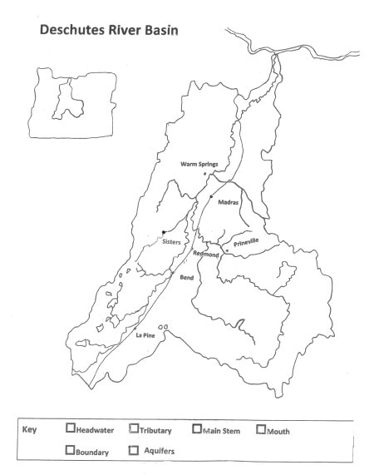

Slide 8
Who are the water users of Central Oregon?

Slide 9
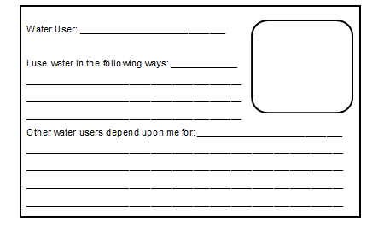
Creating a water user profile

Slide 10
Water user profile sample

Slide 11
Discussion:
1. What do our results suggest we value as a classroom?
Discussion:
6. What responsibilities do water users have if they are given water?
Discussion:
4. Is one water user more important than all the others? What values or attitudes shape that belief?
Discussion:
5. When decisions about water allocation have to be made, do you think it’s possible to please every water user in our region?
Discussion:
3. What should happen when a water user negatively impacts water quality or consumes too much?
Discussion:
2. Are there water users who did not receive tokens? How might this affect other water users?

Slide 12
Part II:
Water Conservation

Slide 13
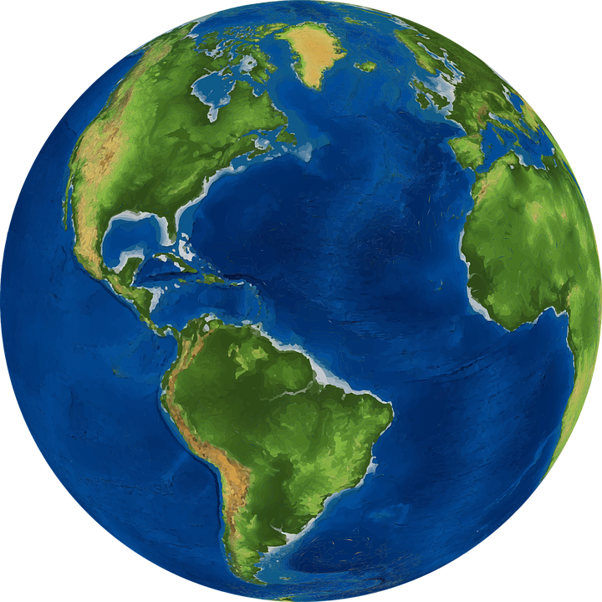
How much?

Slide 14
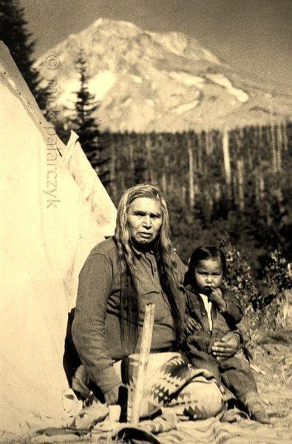
The State of Our Basin
8,000 BCE
Native Americans use the Deschutes River as a source for salmon and a travel route to the Columbia River. Grounds around the river are used for hunting and gathering.
Notes:
the Tygh (Tayxɫáma), or "Upper Deschutes“ people: their principal summer village was at the Upper Deschutes River and their principal winter village at the site of today's Tygh Valley, Oregon; they were divided into three local village groups - the dominant Tayxɫáma (at Tygh Valley), the Tiɫxniɫáma (Sherar's Bridge below Sherars Falls) and the Mliɫáma (along Warm Springs River on present Warm Springs Indian Reservation).
The Wyam (Wayámɫáma) or "Lower Deschutes", also known as "Celilo Indians": their summer village was at Celilo Falls known to the Native Sahaptin people as Wyam ("echo of falling water" or "sound of water upon the rocks") on the south bank of Columbia River and their winter village on the left bank of the Lower Deschutes River just above its junction with the Columbia River (another source locates the winter village Wanwa'wi on the west bank of Deschutes River immediately south of the confluence with the Columbia.)[1]

Slide 15
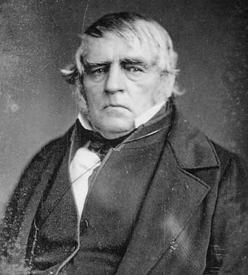
The State of Our Basin
1813
Peter Skene Ogden (Hudson’s Bay Company) sends fur trappers to Central Oregon. This deeply affected the lives of Native Americans in the region. Homesteading began shortly thereafter.
Notes:
Fur trading dramatically affected Native Americans, for better and worse. While it provided economic advantages, it also depleted local sources of food and materials, such as the beaver. It also influenced later migration movements of euro-American settlers.

Slide 16
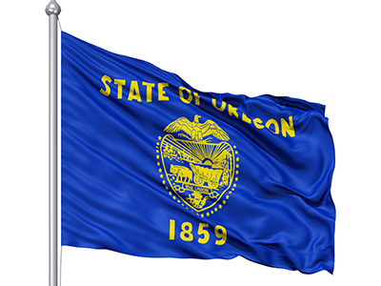
The State of Our Basin
1859
On February 14th, 1859 Oregon becomes a state.
It was the 33rd state to
join the union.
Notes:
At the time of statehood, Native Americans were now under the control of the Office of Indian Affairs (now known as the Bureau of Indian Affairs). Many Native tribes were now resolved to live on reservations and use of the Deschutes River was restricted.
Slavery also played a major part in Oregon's history and even influenced its path to statehood. The territory's request for statehood was delayed several times, as members of Congress argued among themselves whether the territory should be admitted as a "free" or "slave" state. Eventually politicians from the south agreed to allow Oregon to enter as a "free" state, in exchange for opening slavery to the southwest United States.

Slide 17
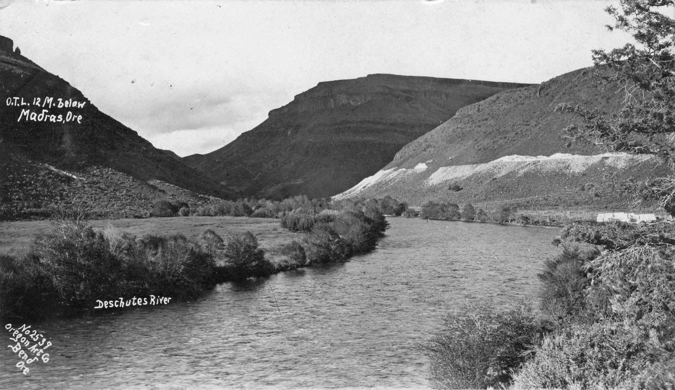
The State of Our Basin
1894
The Carey Act allows the Deschutes River to be used for irrigation purposes. Private companies were now allowed to profit from the sale of water in the arid West.
Notes:
On August 18, 1894, President Grover Cleveland signed the Desert Land Act of 1894, better known as the Carey Act. Sponsored by Wyoming Senator Joseph M. Carey, the Act was meant to improve the success rate for the settlement of the public lands. The law specifically addressed the millions upon millions of acres in the western states that required irrigation for productive farming—the so-called ‘arid lands.’
The Act authorized the Federal Land Office to transfer up to a million acres of arid public lands to individual states that established approved reclamation programs. States would cover expenses by charging fees and selling the land at nominal prices, with the real incentive being the expected increase in tax revenue.
Development companies proposed, designed, and built suitable irrigation projects. They profited by selling water to the settlers, at rates determined in negotiations with the state reclamation office. The development company did not ‘own’ the land itself—technically. However, these firms could place liens on the land and the associated water rights to protect their capital investments so the effect was basically the same.
This entry was posted in Year 2 This Day in Water History and tagged Carey Act, Idaho, irrigation, water, water history on August 18, 2014.

Slide 18
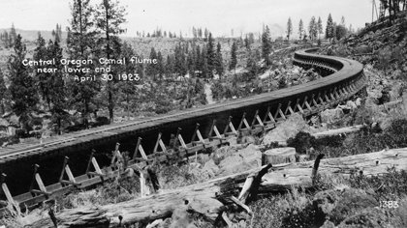
The State of Our Basin
1904
Several irrigation companies complete canals to irrigate thousands of acres of Central Oregon farmland, changing the flow rate of the Deschutes River.
Notes:
In 1904 the Deschutes Irrigation and Power Company through the Pilot Butte Canal brought water to fertile areas in the new Central Oregon Bend development. Development and settlement in Bend was largely due to new irrigation projects that created a landscape for agriculture, ranching, and milling.

Slide 19
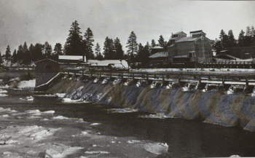
The State of Our Basin
1910
The Deschutes River is dammed, creating Mirror Pond. Downtown Bend residents receive electricity from this project
Notes:
“Bend will have electric lights in the near future. A. M. Drake has fully decided to put in a dam and power plant and will supply the town with the long desired electric system,” the Bend Bulletin reported in 1910. The decision was made to dam the river and bring power to Bend. Later in the year the paper gave us: “A remarkably beautiful pond will result from the dam’s completion, which, situated directly beside the town, will add a notable feature to Bend’s list of attractions.”
The damming of the Deschutes leads to increased water temperatures and sedimentation build up. Native trout, salmon and steelhead thrive best in water temperatures below 62 degrees. Temperature rises in the Deschutes have led to decreased fish populations over the past 100 years.

Slide 20
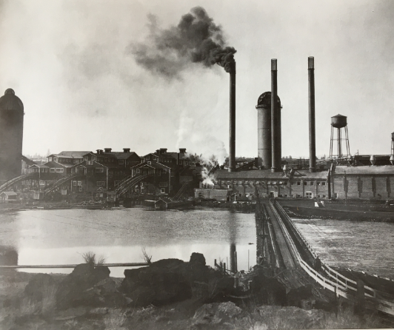
The State of Our Basin
1911
Brooks Scanlon and Shevlin-Hixon set up mills along the Deschutes River. The mills spur a population growth by providing jobs. They also add pollutants to the river.
Notes:
Both mills were incredibly successful. During WWII, the mills held the top two positions for profit and production. During the war they produced pine boxes and crates which carried supplies overseas. The mills drew new citizens to the Bend area, but also introduced pollutants into the watershed. Due to their location on either side of the Deschutes, smokestacks, oils from lubrication, and the creosote used to coat the bridges that carried equipment over the river, led to a decrease in water quality.

Slide 21
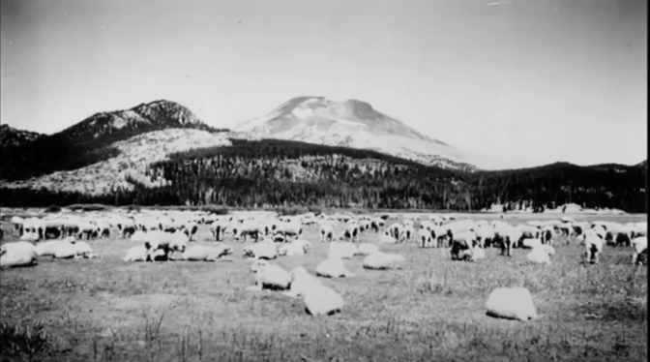
The State of Our Basin
1920
Pollution from upstream flooding and agriculture affects water quality. The Deschutes River is condemned for human consumption. The City of Bend looks elsewhere for its drinking water.
Notes:
Runoff from agriculture can have increased amounts of nitrogen. Nutrients, such as nitrogen and phosphorus, are essential for plant and animal growth and nourishment, but the overabundance of certain nutrients in water can cause a number of adverse health and ecological effects.

Slide 22
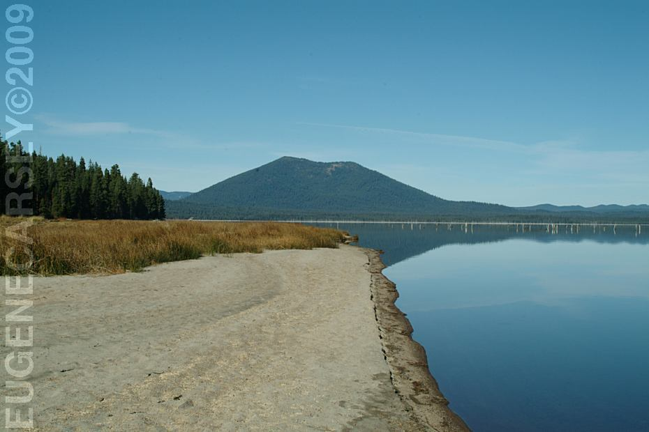
The State of Our Basin
1922
Crane Prairie Dam construction is completed, first blocking the flow of the Deschutes River and storing water for irrigation season.
Notes:
Up to 98% of the streamflow from the Deschutes River at Bend is diverted through irrigation canals during the summer irrigation season. Almost half of this water seeps into the
porous volcanic soil before it reaches the farms. Crane Prairie provides water to Central Oregon, Arnold, and Lone Pine irrigation districts.
https://www.google.com/search?q=crane+prairie+reservoir&source=lnms&tbm=isch&sa=X&ved=0ahUKEwjXzPWcxdHcAhUQeawKHT7EBqEQ_AUIDCgD&biw=1920&bih=974#imgrc=rTzAmrYOPtnkcM: Eugene Carsley, 2009.

Slide 23
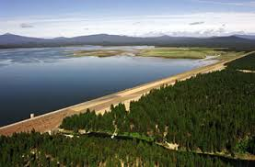
The State of Our Basin
1949
Wickiup Dam is constructed, increasing the quantity of stored water for irrigation. As a result, flow rates range from 20 CFS to 2,000 CFS.
Notes:
Up to 98% of the streamflow from the Deschutes River at Bend is diverted through irrigation canals during the summer irrigation season. Almost half of this water seeps into the
porous volcanic soil before it reaches the farms. Wickiup provides irrigation water for North Unit Irrigation District near Madras. Water takes 5 days from the reservoir outlet to arrive on farms.
http://38.106.5.59/modules/showdocument.aspx?documentid=3626

Slide 24
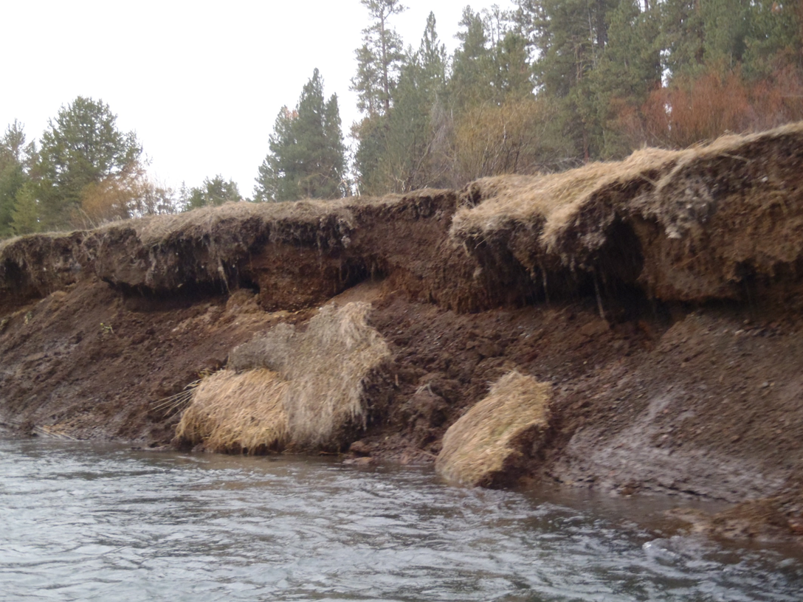
The State of Our Basin
Changes in flow affect the river: Bank erosion
Notes:
Since the storage and release of water from our basin and fluctuating water levels, there is erosion and widening of the river banks.

Slide 25
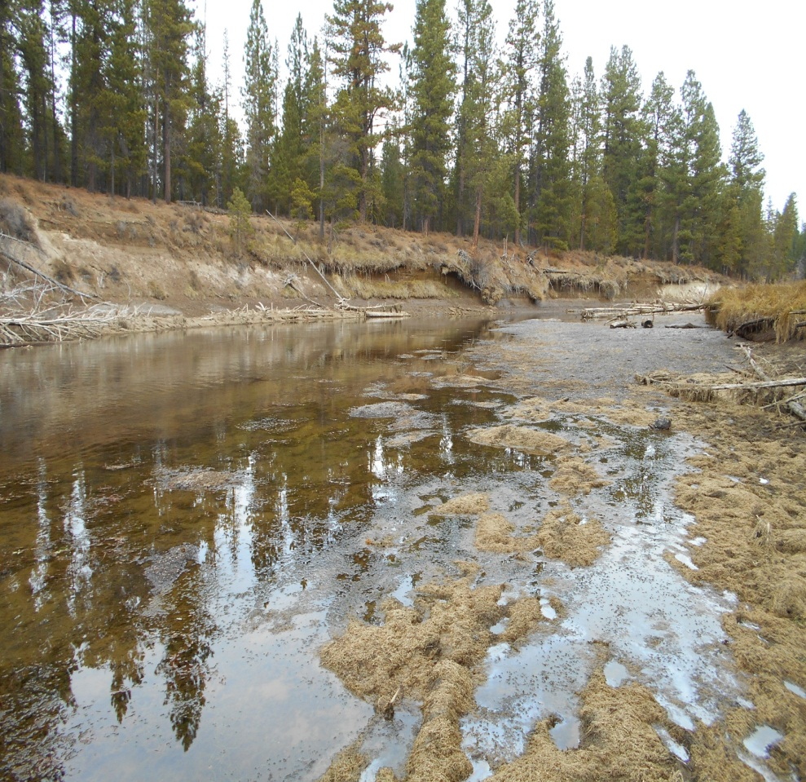
The State of Our Basin
Changes in flow affect the river: Channel widening
Notes:
Since the storage and release of water from our basin and fluctuating water levels, there is erosion and widening of the river banks.

Slide 26
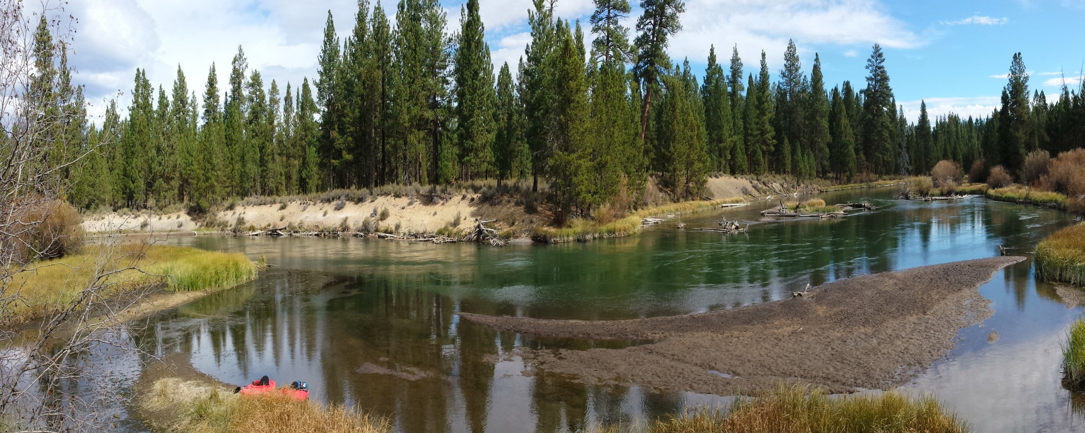
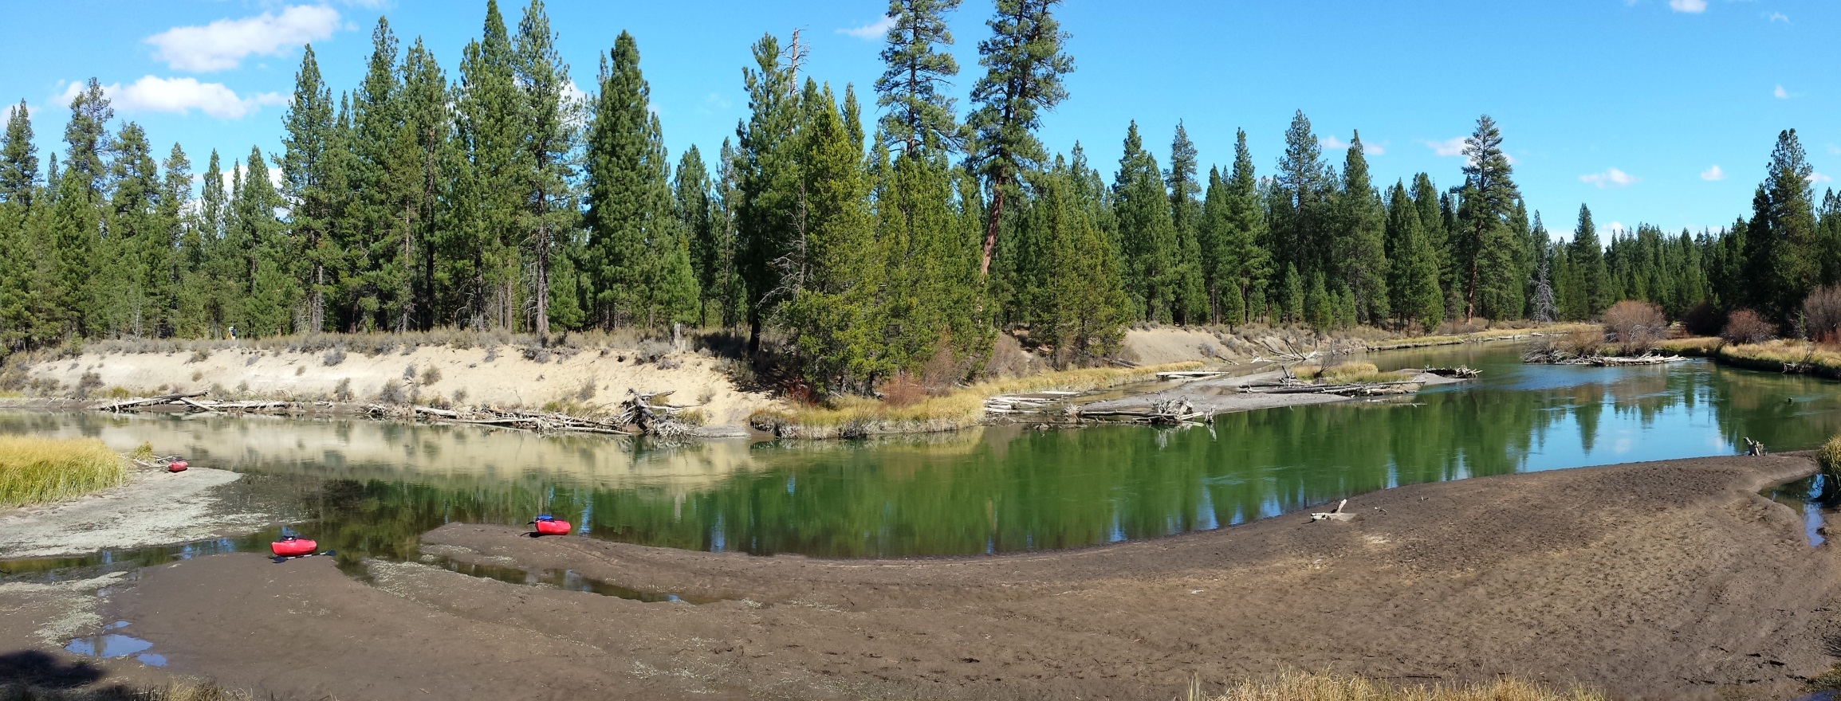
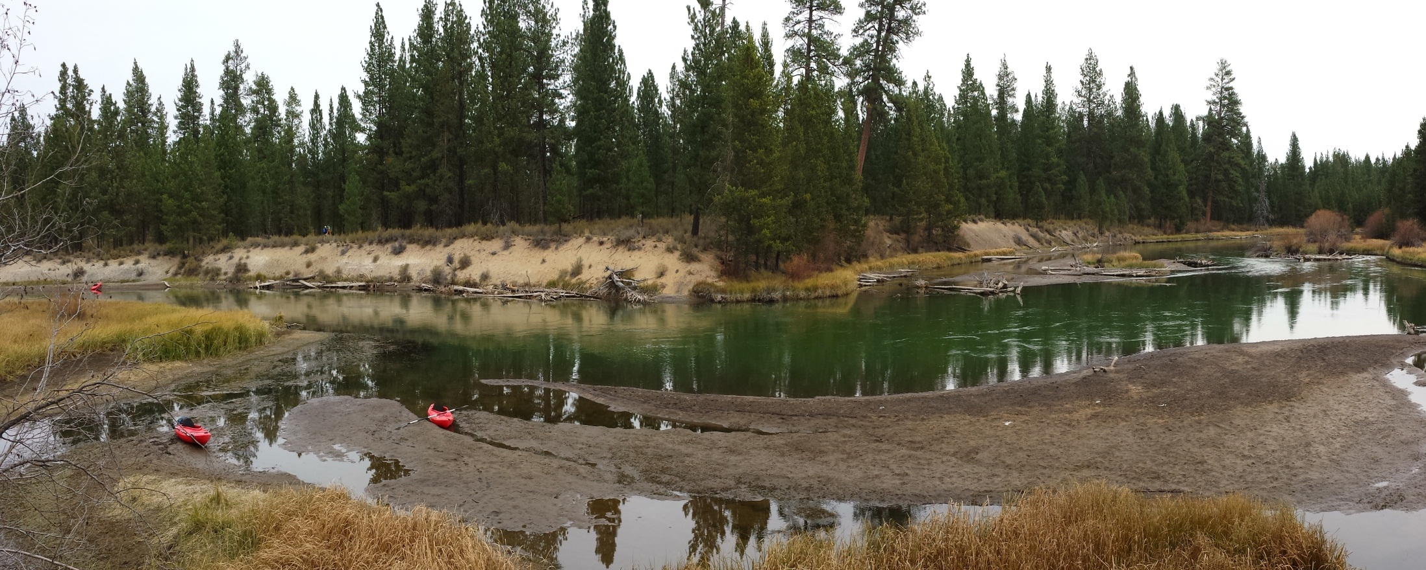
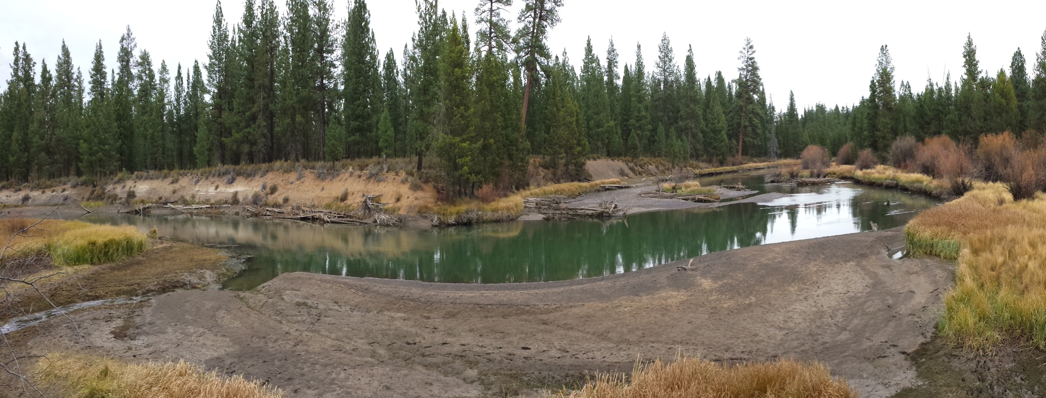
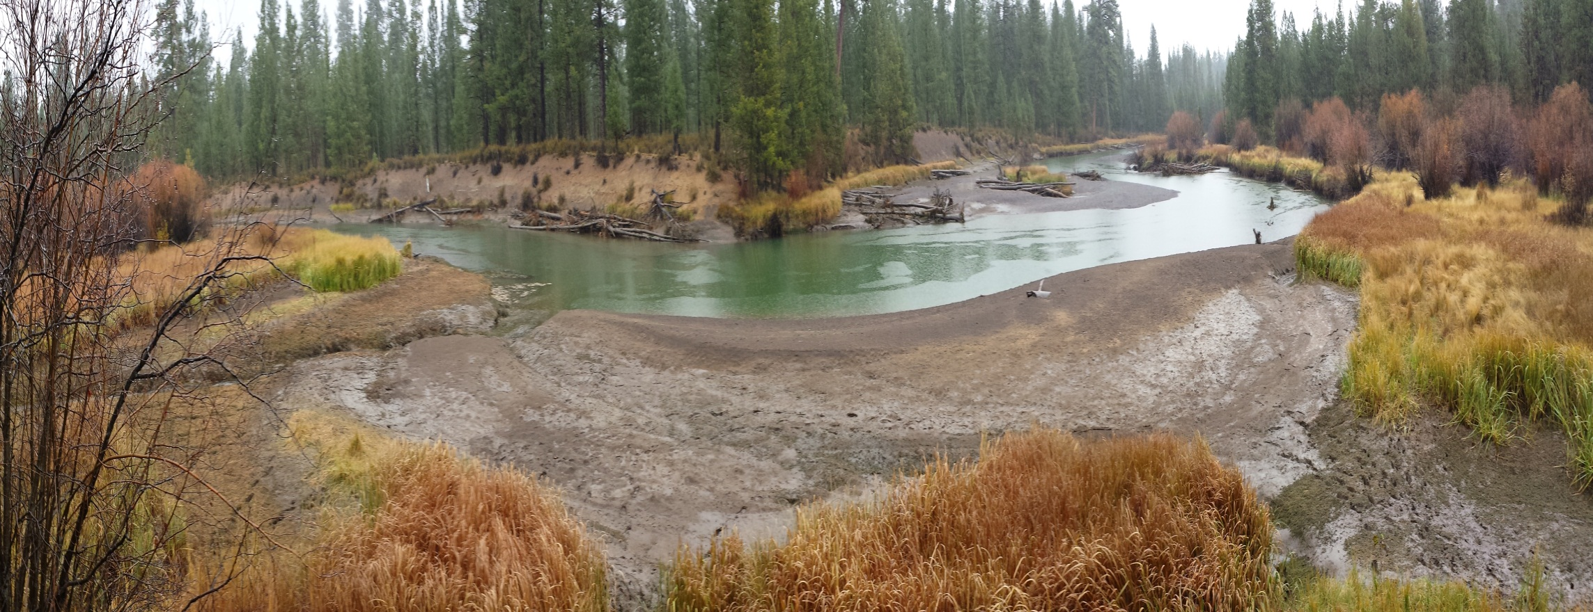
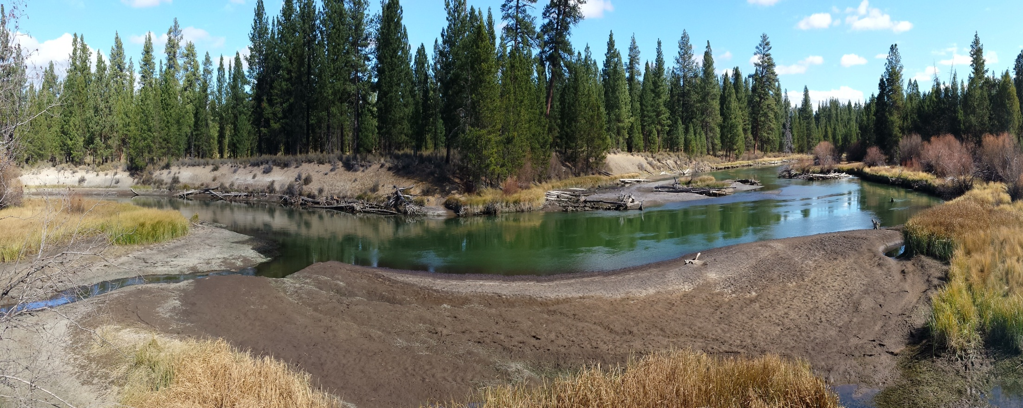
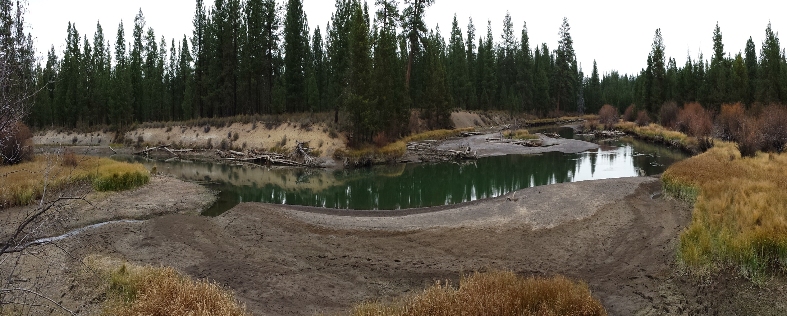
The State of Our Basin
Changes in flow affect the river: Fish and wildlife habitat
Notes:
Photo series represent the rampdown of the river going into storage season
Beginning of the photo series is already half of high flow
Note emerging wood and substrate. Some of this (to the right, mid channel) is where fish would spawn

Slide 27
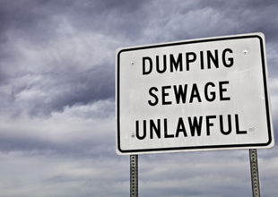
The State of Our Basin
1972
The Clean Water Act is enacted, allowing federal agencies to regulate pollutant discharges into the waters of the United States.
Notes:
As amended in 1972, the law became commonly known as the Clean Water Act (CWA). The 1972 amendments: Established the basic structure for regulating pollutant discharges into the waters of the United States and gave EPA the authority to implement pollution control programs such as setting wastewater standards for industry.

Slide 28
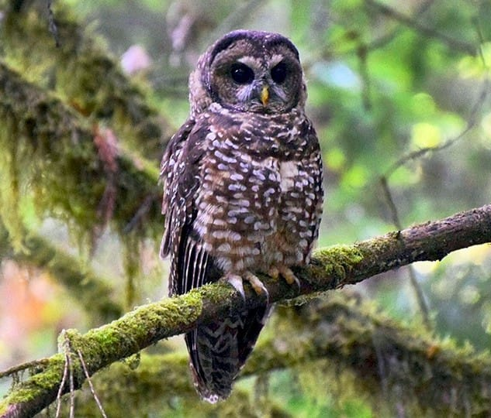
The State of Our Basin
1973
The Endangered Species Act is enacted to protect critically imperelied species from extinction, as well as the ecosystems upon which they depend.
Notes:
As amended in 1973, the law became commonly known as the Endangered Species Act (ESA). Designed to protect critically imperiled species from extinction as a "consequence of economic growth and development untempered by adequate concern and conservation", the ESA was signed into law on December 28, 1973.

Slide 29
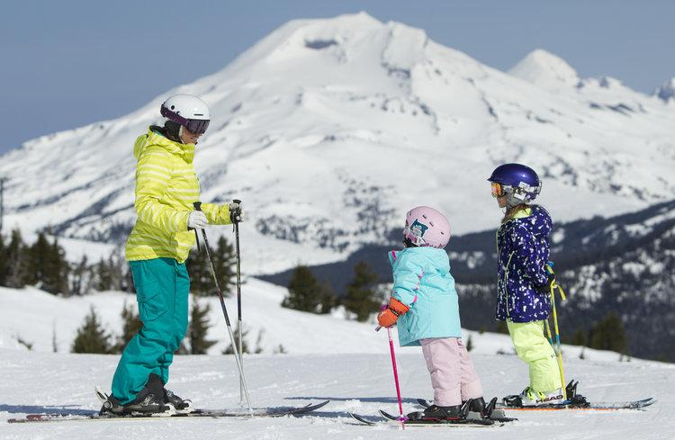
The State of Our Basin
1990
The last mill of Brooks-Scanlon closes. Recreation becomes the leading industry in Central Oregon.
Notes:
Recreation activities such as skiing, bring tourists from all over the world to Central Oregon. Businesses begin to reflect plans to maximize profits based off of tourism. This is a fundamental shift in the region. Ranching and farming still remain important sources of revenue, but with the mills closing, many workers are forced to find other occupations.

Slide 30
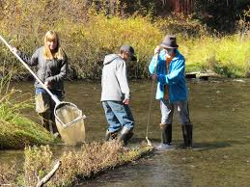
The State of Our Basin
1996
The Upper Deschutes Watershed Council is established, aiming to restore the 2,000,000 – acre Upper Deschutes River Watershed
Notes:
Since 1996, the Upper Deschutes Watershed Council (UDWC) has worked to protect and restore the 2,000,000-acre upper Deschutes River watershed through collaborative projects in watershed restoration, monitoring and community awareness. With local support from landowners, ranchers, environmental interests, local citizens, and representatives from local governments and agencies, we lead cooperative, grass-roots efforts to improve watershed conditions. This grass-roots approach ensures that a balance of affected and interested stakeholders is involved to craft effective management strategies for our watersheds.

Slide 31
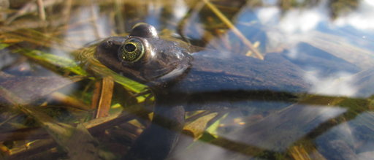
The State of Our Basin
2014
The Oregon spotted frog is listed as a threatened species under the Endangered Species Act. This spurs more conservation efforts by water users, including irrigation districts.
Notes:
This species is the most aquatic native frog in the Pacific Northwest. It is almost always found in or near a perennial body of water that includes zones of shallow water and abundant emergent or floating aquatic plants, which the frogs use for basking and escape cover (Leonard et al. 1993, Corkran and Thoms 1996, McAllister and Leonard 1997, Pearl 1997, Pearl 1999). Oregon spotted frogs seem to prefer fairly large, warm marshes (approximate minimum size of 4 hectares (9 acres)) that can support a large enough population to persist despite high predation rates (Hayes 1994) and sporadic reproductive failures. Large concentrations of Oregon spotted frogs have been found in areas with the following characteristics: (1) the presence of good breeding and overwintering sites connected by year-round water; (2) reliable water levels that maintain depth throughout the period between oviposition and metamorphosis; and (3) the absence of introduced predators, especially warm-water game fish and bullfrogs.
https://www.fws.gov/oregonfwo/articles.cfm?id=149489458

Slide 32
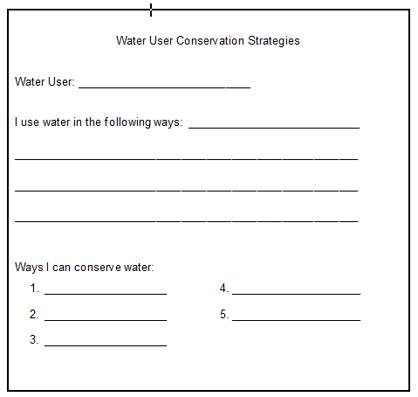

Slide 33
Discussion:
6. What can you do as a domestic water user to conserve?
Discussion:
5. What options do we have when there isn’t enough water to satisfy all of the users?
Discussion:
Why do people feel strongly about some users and not others?
Discussion:
2. What attitudes or beliefs shape our decisions about what we value?
Discussion:
4. When decisions about water allocation affect a large group of people, do you believe you can satisfy all users?
Discussion:
3. What changes or factors might influence a different decision about who receives water?

